Slide 1




PROJECT ON
MOVIE SALES ANALYSIS
BY :- Pruthviraj Hanumant Patil

Slide 2









OBJECTIVE
The objective of this project is to analyze and visualize movie industry data using Power BI to uncover key insights related to box office performance, genre trends, audience ratings, and top-performing actors and directors. By transforming raw movie data into interactive dashboards, the goal is to help stakeholders understand revenue trends, evaluate viewer preferences, and make data-driven decisions in the entertainment domain.

Slide 3
About the Dataset
Rank: Position of the movie in the overall ranking list.
Title: Name of the movie.
Genre: Primary genre(s) such as Drama, Action, Comedy, etc.
Description: A short summary of the movie’s plot.
Director: Name of the movie's director.
Actors: Main actors featured in the movie.
Year: Year the movie was released.
Runtime (Minutes): Duration of the movie in minutes.
Rating: Average IMDb rating (scale of 1 to 10).
Votes: Number of user votes received.
Revenue (Millions): Box office revenue in millions of USD.
Metascore: Critic score from Metacritic (scale of 0 to 100).

Slide 4

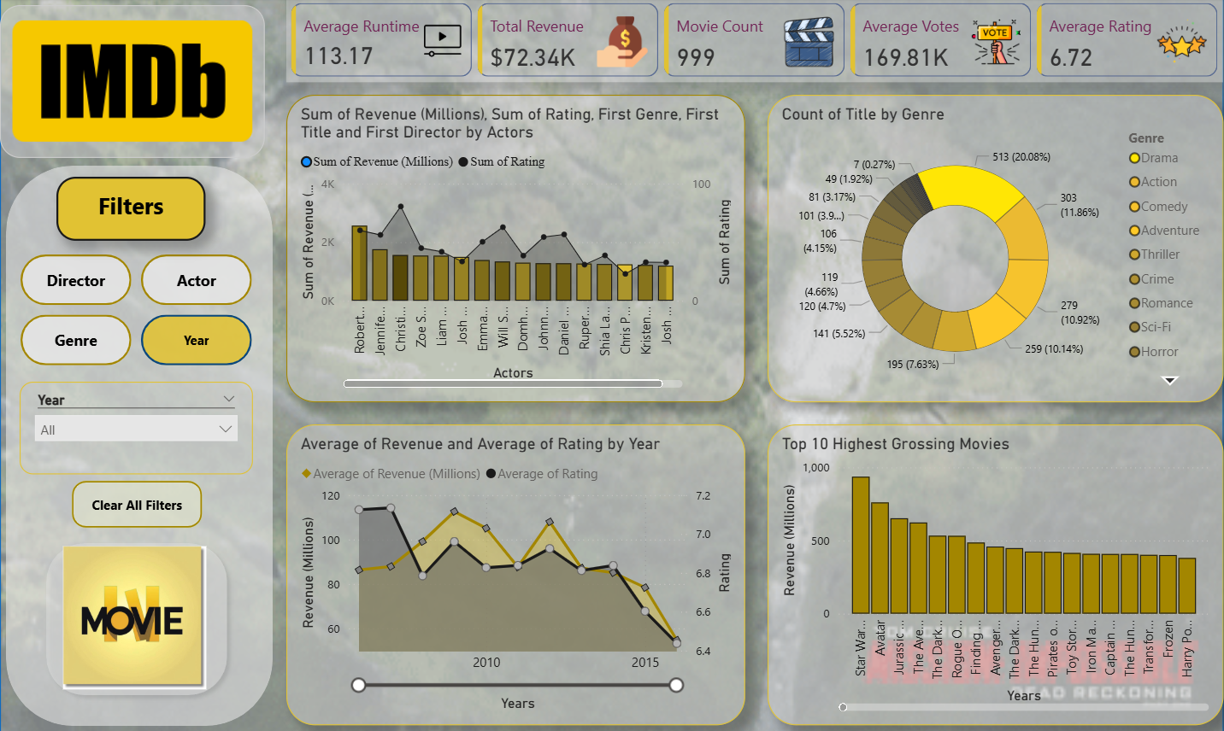
POWER BI REPORT

Slide 5
Movie Trends Over the Years
📅 Most Movies Released: 2015 and 2016 recorded the highest number of movie releases.
💰 Highest Revenue Year: 2016 generated the highest total box office revenue.
⭐ Stable Ratings: Average IMDb ratings remained stable between 6.3 to 7.2 across most years.
🕒 Average Runtime: Consistent around 113 minutes, showing no major shift in movie length over time.
🗳️ Votes per Movie: Audience engagement varied, with a few peak years showing higher vote counts.

Slide 6
Genre & Rating Analysis
🎭 Most Common Genre: Drama dominates with 20% of total movies.
🎥 Other Popular Genres: Action, Comedy, and Adventure are frequently represented.
💰 Revenue Distribution: Action and Adventure genres typically contribute the most to total revenue.

Slide 7
Top Performers & Revenue Leaders
🎬 Top-Grossing Movie: Star Wars tops the list with over $900 million revenue.
🧑‍🤝‍🧑 Highest Revenue Actors: Robert Downey Jr. , Jennifer Lowrance, Christian Bale.
lead based on total box office earnings.
📈 Revenue Gap: Top 10 movies significantly outperform the rest in revenue.
🎞️ Total Movies Analyzed: 999
💵 Overall Revenue Tracked: $72.34 billion .

Slide 8
Conclusion
Analyzed 999 movies across multiple genres and years.
2010 had the highest revenue; 2006 & 2015 saw the most releases.
Drama was the most common genre.
Total revenue analyzed: $72.34 billion USD.
IMDb ratings remained steady over time.
Top actors like Robert D., Jennifer L., Chris P. led in revenue.
Power BI enabled clear, data-driven insights through interactive visuals.

Slide 9
Thank You

